Slide 1


Unlocking the Power of Machine Learning
Join me on a journey through the world of machine learning as we explore neural networks, decision trees, random forests, and more.

Slide 2
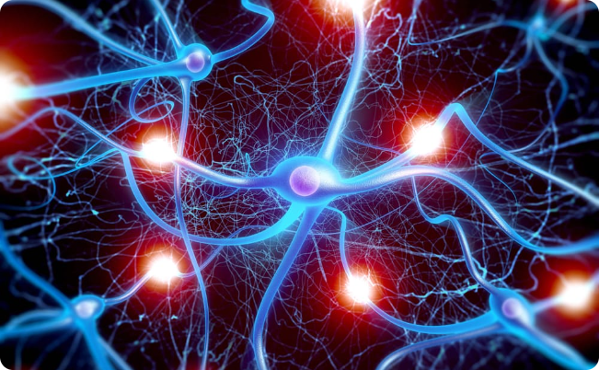
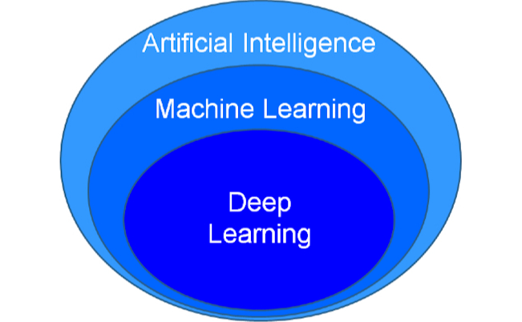
Neural Networks: The Building Blocks of AI
Artificial Neurons
Deep Learning
Discover how artificial neurons are connected to form powerful models that can learn patterns and make predictions.
Dive deep into state-of-the-art deep learning techniques, including convolutional neural networks (CNNs) and recurrent neural networks (RNNs).

Slide 3
Decoding the Mystery of Decision Trees
Structure and Function
Interpretability and Explainability
Example: Predicting Loan Approval
Unveil the inner workings of decision trees and their ability to make decisions based on a series of rules and conditions.
Learn why decision trees are popular for their interpretability, making them valuable in fields where understanding the decision-making process is crucial.
Walk through a real-life scenario where a decision tree helps determine whether a loan applicant is likely to be approved or not.

Slide 4
Random Forests: The Power of Ensemble Learning
1
Combining Strengths
Discover how random forests leverage the diversity of decision trees to make robust and highly accurate predictions.
Reducing Overfitting
2
Explore how the random forest algorithm mitigates overfitting and improves generalization through the principles of bagging and averaging.
3
Comparing Decision Trees and Random Forests
Uncover the key differences between decision trees and random forests, and understand when to choose one over the other.

Slide 5
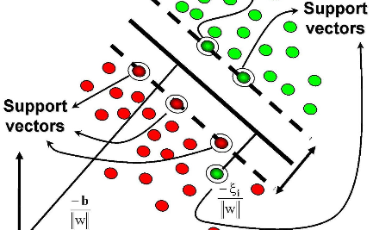
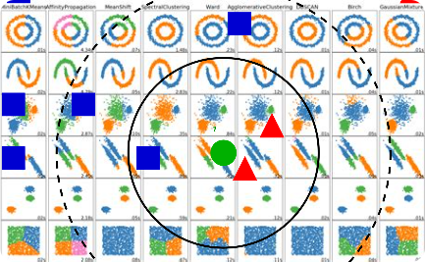
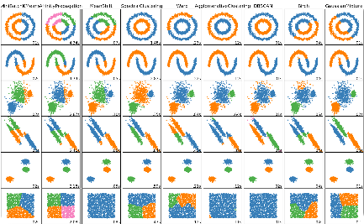
A Glimpse into More Machine Learning Algorithms
Support Vector Machines (SVM)
k-Nearest Neighbors (k-NN)
K-Means Clustering
Explore the unsupervised learning technique of grouping data into clusters based on their similarity, revealing hidden patterns and structures.
Learn about the mathematical concepts behind SVMs and how they can classify data by finding the best separating hyperplane.
Discover how k-NN works by finding the closest neighbors in feature space and making predictions based on their labels.

